Slide 1
The Strategic Benefits of Chess: A Game-Changer in Education and Beyond

Slide 2




Introduction
Chess is a
game with profound
implications for and beyond. Its beneﬁts extend to critical thinking, problem-solving, and decision-making skills. This presentation explores the
of chess and its potential as a game-changer in various domains.

Slide 3




Enhancing Critical Thinking
Chess fosters by requiring players to analyze complex situations, anticipate opponents' moves, and make decisions based on long-term strategies.
This process enhances cognitive abilities and prepares individuals for
in various contexts.

Slide 4
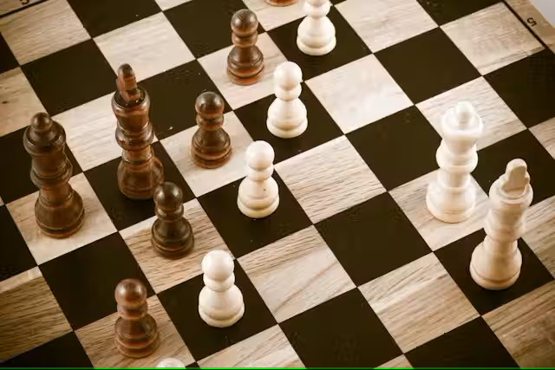


Educational Impact
In the realm of , chess has been linked to improved academic performance, particularly in subjects requiring and problem- solving. It promotes intellectual growth, enhances concentration, and cultivates a
essential for success.

Slide 5

Conclusion
In summary, our chess project has been a collaborative effort that has deepened our understanding of both chess gameplay and software development. Through meticulous design and implementation, we have crafted an engaging user experience that caters to players of all levels. Moving forward, we aim to enhance our project with advanced features such as AI opponents and online multiplayer functionality. We are proud of our achievements thus far and look forward to further refining and expanding our project to provide an immersive and enjoyable chess experience for all.

Slide 6
Thanks!
Submitted By:-
Dipankar Sethi
2210990287
G-30
Submitted To:-
Dr. Rajendra
Mentor G-30

